Slide 1
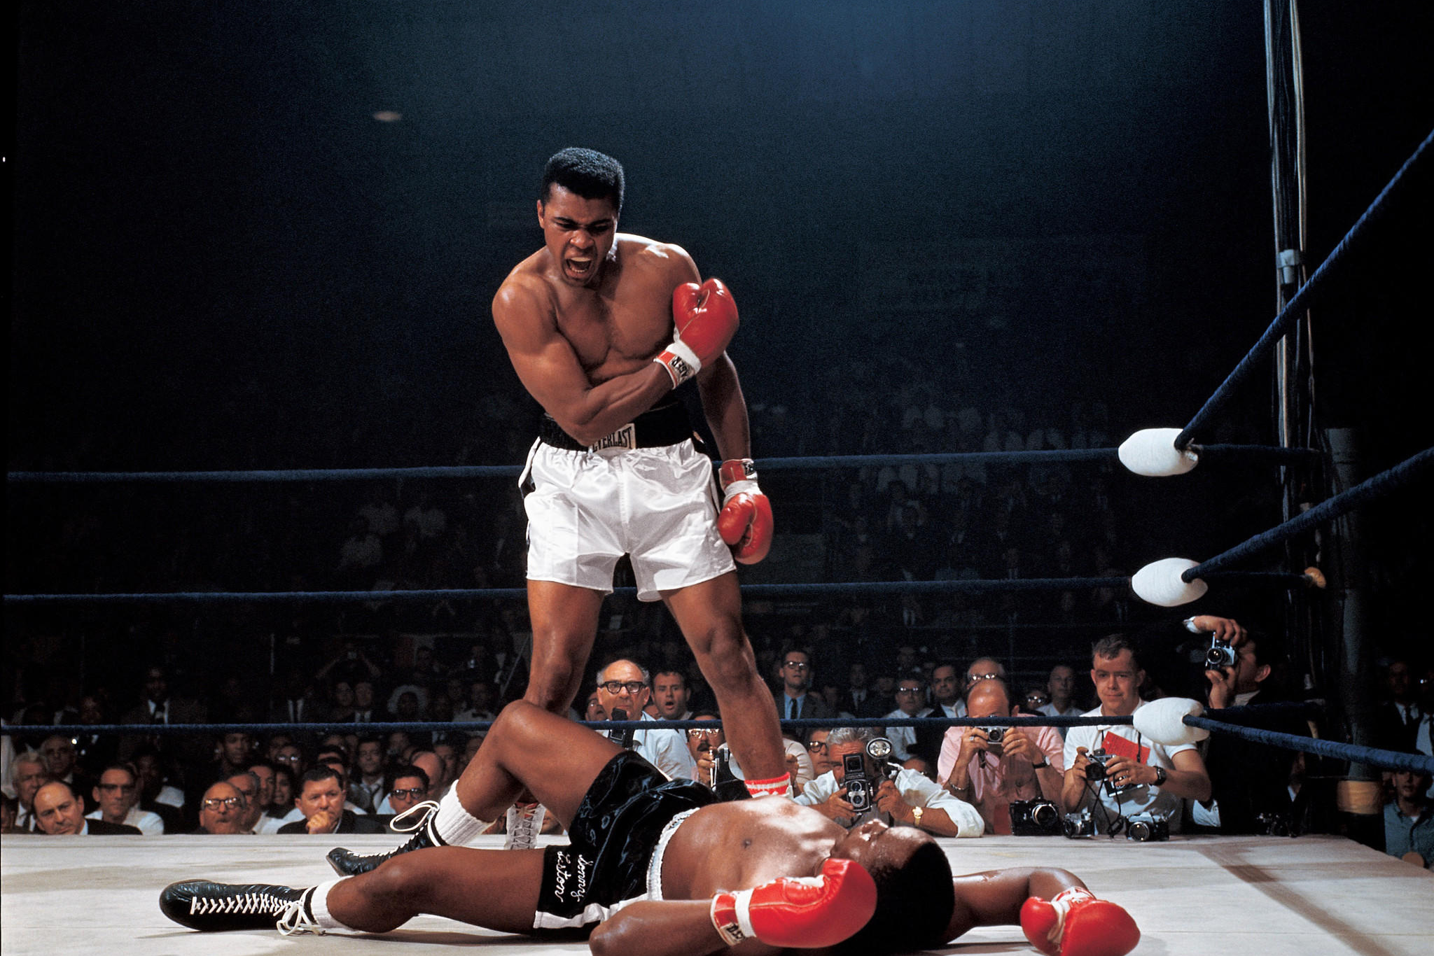
Team 4: YoungJo Choi
Wenxuan Zhu
Ameer Ali
Instructor: Prof. Jafar Saniie
ECE 501, Artificial Intelligence and Edge Computing, Summer 2023
Final
Report
Counting the number of Punches thrown in Boxing Matches, using Computer Vision and AI Algorithms.

Slide 2


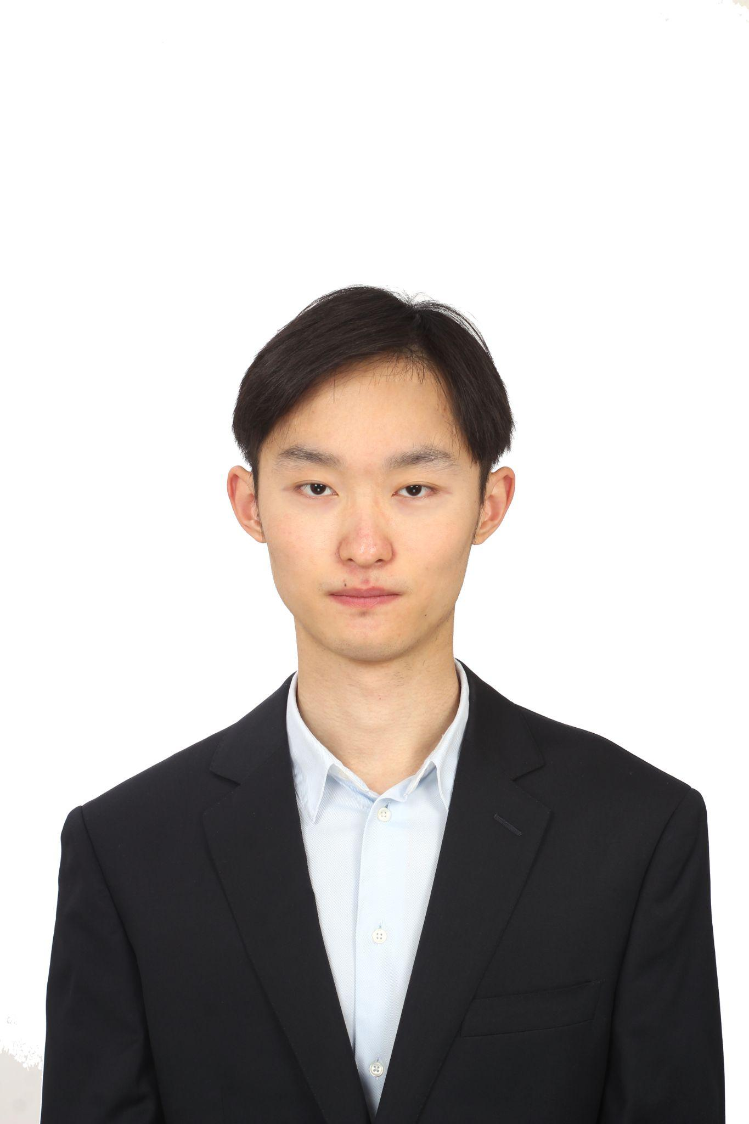
Team 4
YoungJo Choi
Ameer Ali
B.S. Computer Engineering
Research interest
: AI and Data Science
B.S. Bioinformatics
MAS Artificial Intelligence
Focused on computer vision and NLP models
Wenxuan Zhu
B.S. Electrical Engineering
M.S. Electrical and Computer Engineering
Focused on the machine learning and computer vision field

Slide 3
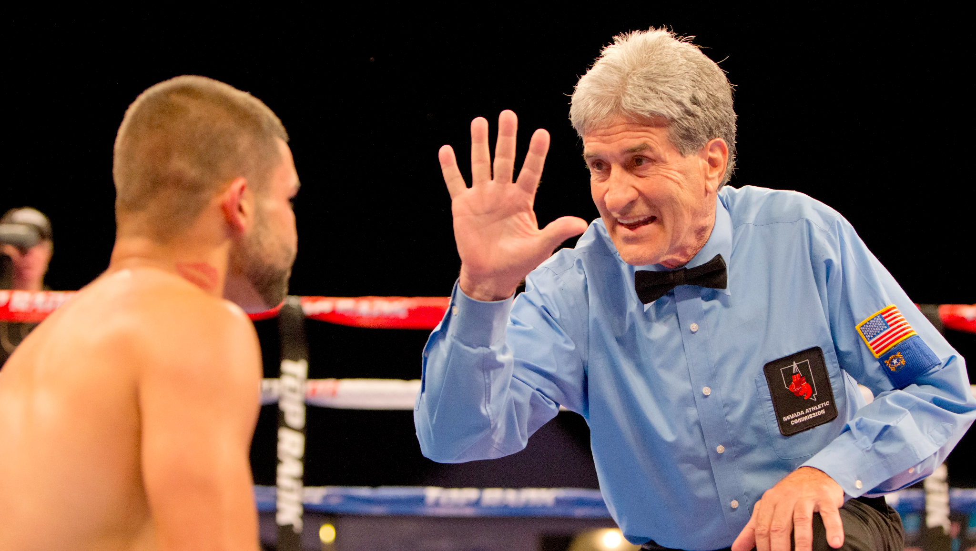
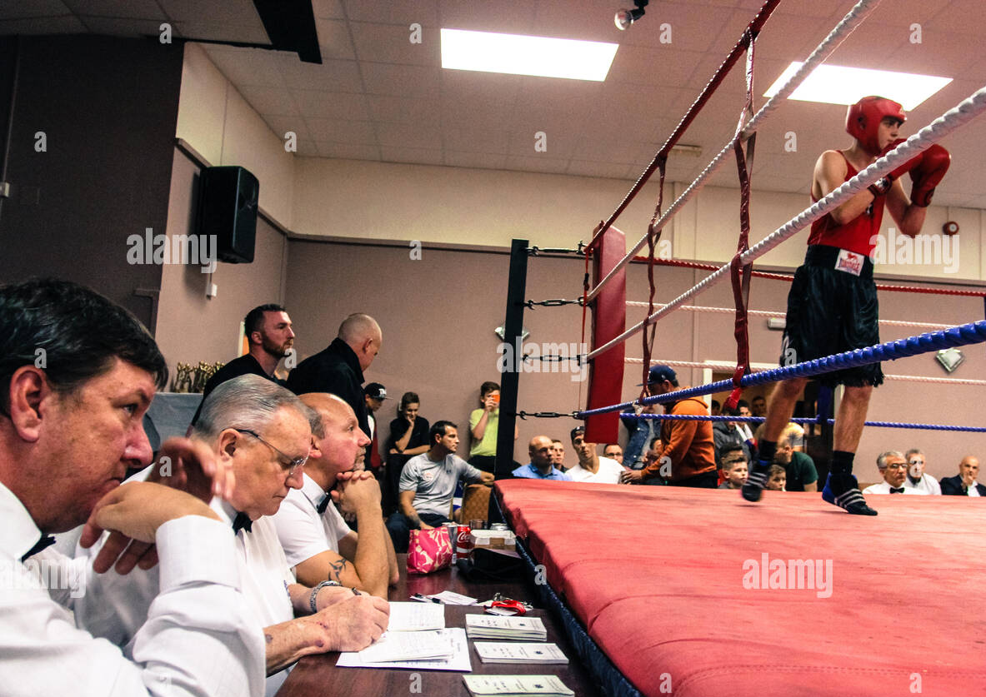
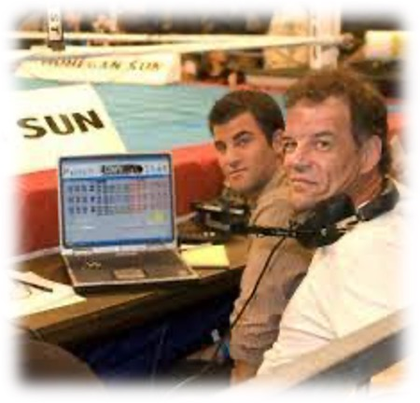
current scoring
Referee can stop a match when one player cannot continue the match.
Three judges are seated at ringside
Two operators just count punches,
whether it was straight, hook, or uppercut.

Slide 4
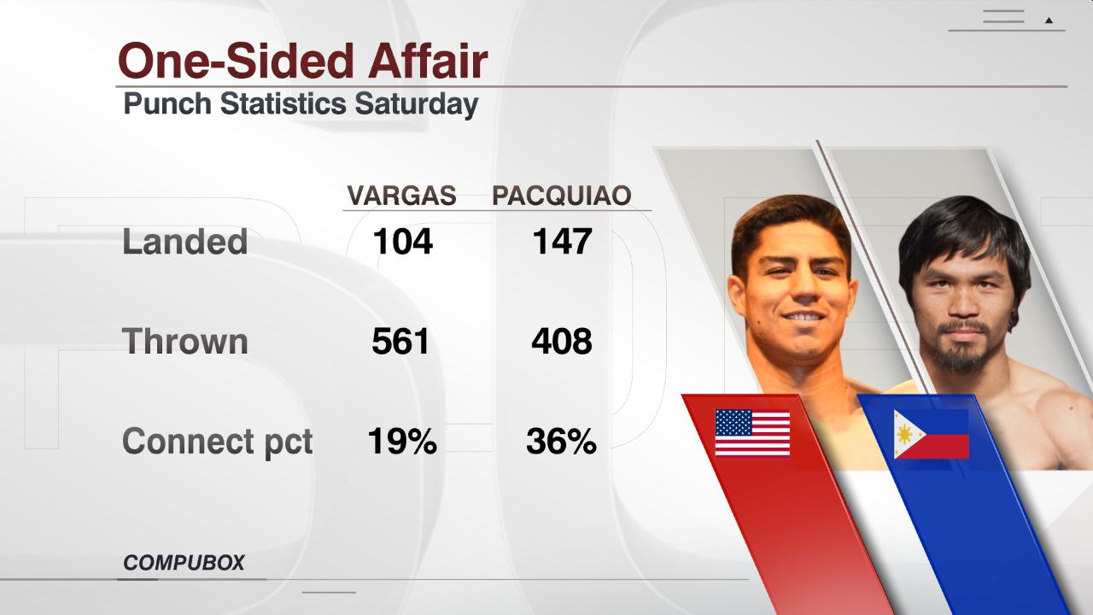
Problem Statement

Slide 5
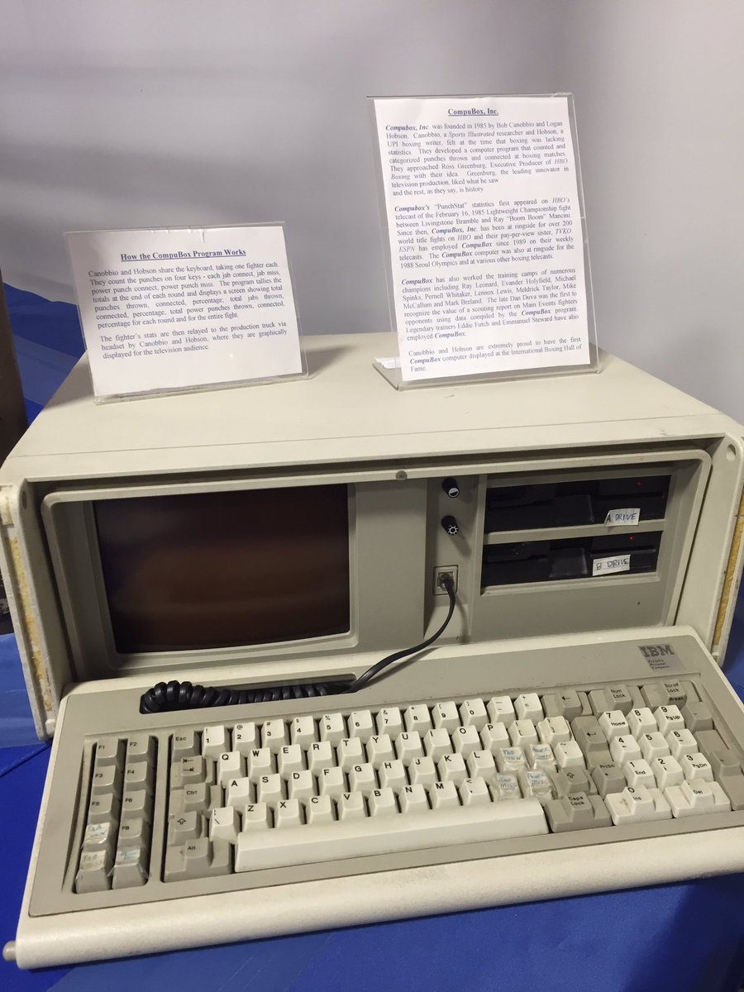
Current System: CompuBox
01
Manually counted by 2 operators.
Two operators manually count each lead hand land, miss and rear hand miss and land.
02
Let’s build our own program,
which more accurately count punches.
Subjective that can be biased.
Inaccurate.

Slide 6
Compubox
Two operators manually count punches.
Audience can’t see statistics when it’s now shown.
Our program
We can automatically count landing punches.
Audience can reference statistics on time.
It can be applied to lots of boxing matches.

Slide 7
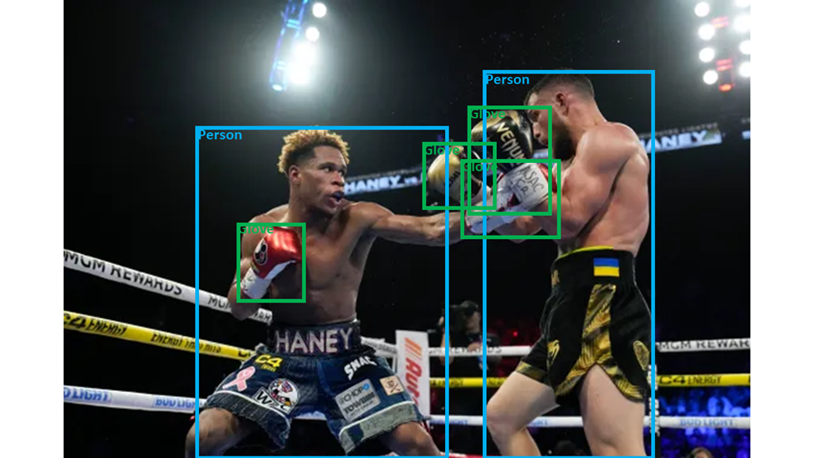
Our Project
Counting the number of Punches thrown in Boxing Matches, using Computer Vision and AI Algorithms.
Data Collection / Labeling
Object
detection
Algorithm
(Public Dataset)
Custom Dataset
Use RoboFlow
YOLO version8
OpenCV
TensorFlow
Numpy
Compute the distance between a boxer and the boxer.

Slide 8
Approaches
Data Collection / Labeling
01.
02.
03.
[Public Dataset]
Custom Dataset
Preprocess data
: With the dataset, we input basic gloves and boxers.
Roboflow
: Manually label each boxing gloves and boxers when a punch is being landed.
If we need to enhance the quality of data.
Instance Segmentation
: Instead of object detection (Bounding box), we adopted instance Segmentation in labeling, because it is proper to detect local variables.

Slide 9
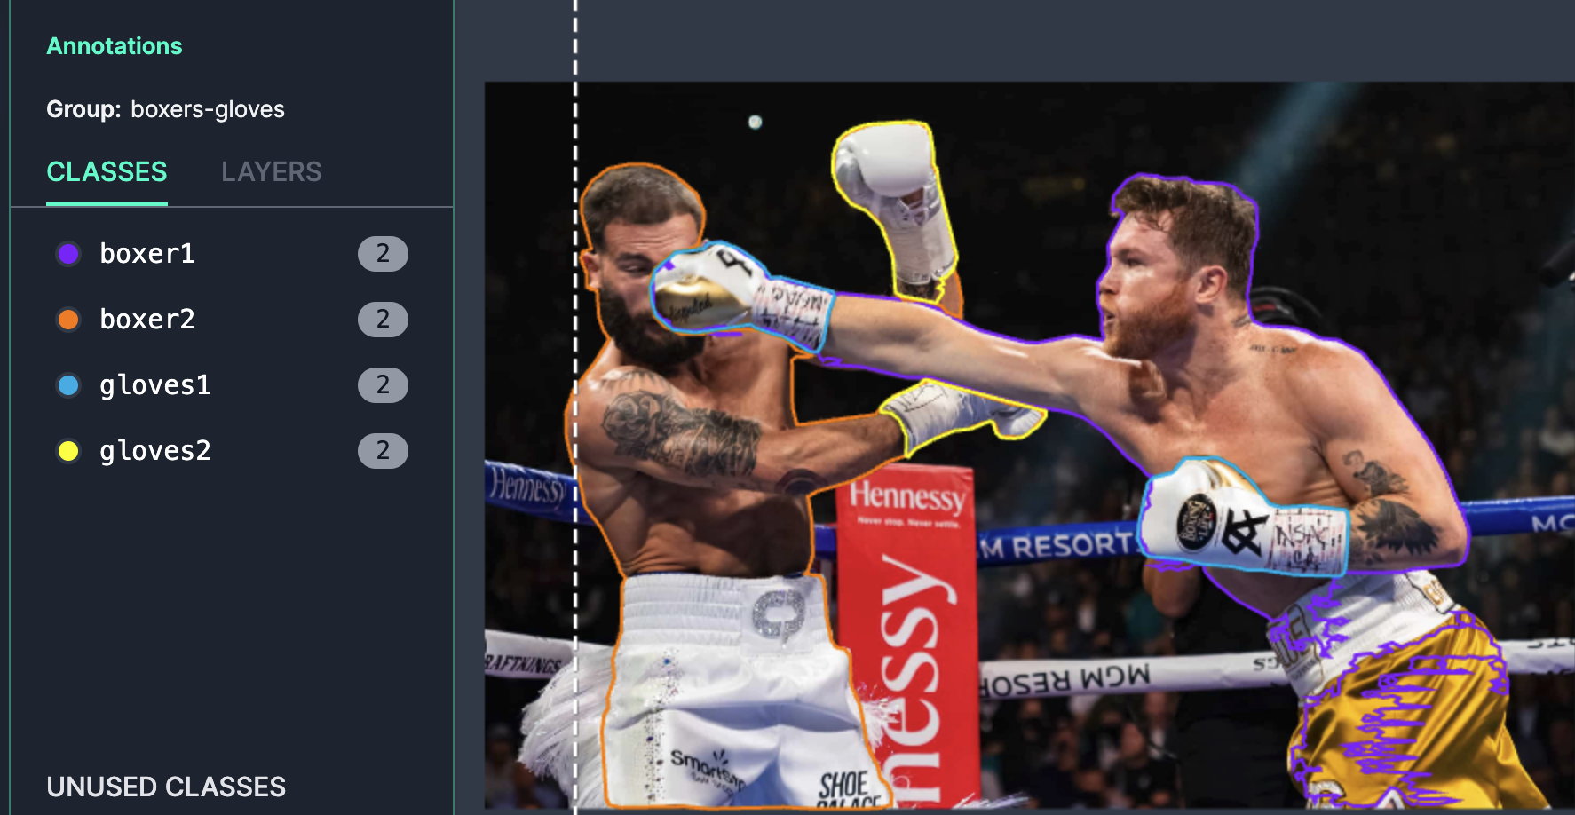
Data Collection / Labeling
Labeling
01.
object detection (Bounding box)
02.
Instance Segmentation

Slide 10
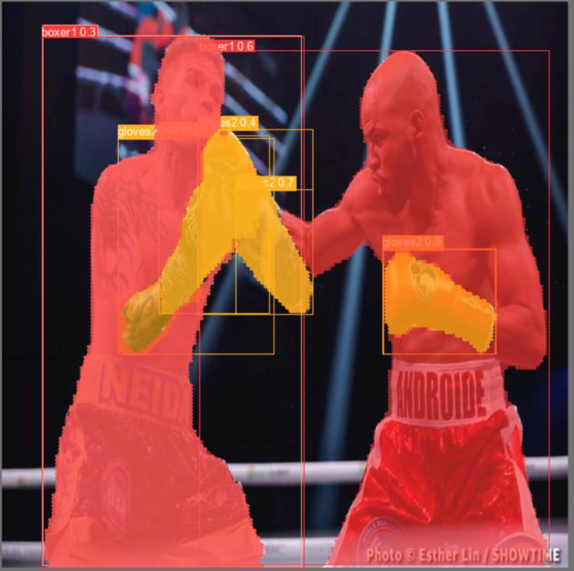
Approaches
Object Detection
Algorithm to identify punches
YOLO
version 8
Punch counting algorithm
OpenCV
Tensorflow
Numpy
Using YOLO version 8, we will input dataset that we created in Roboflow.
We compute the center of object boxes and measure the distance between boxer and his glove.
If the distance is larger than certain amount, then we assume this is punch.

Slide 11
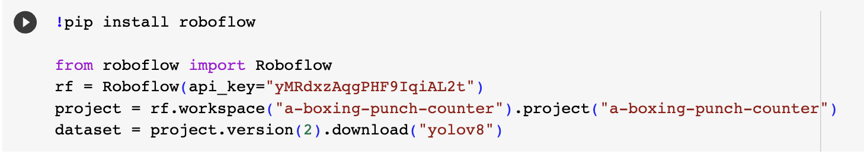
Prototype
01.
Instance Segmentation
Using Roboflow
Labeled about 30 images on Roboflow.
02.
Test Object detection
Using YOLOv8

Slide 12
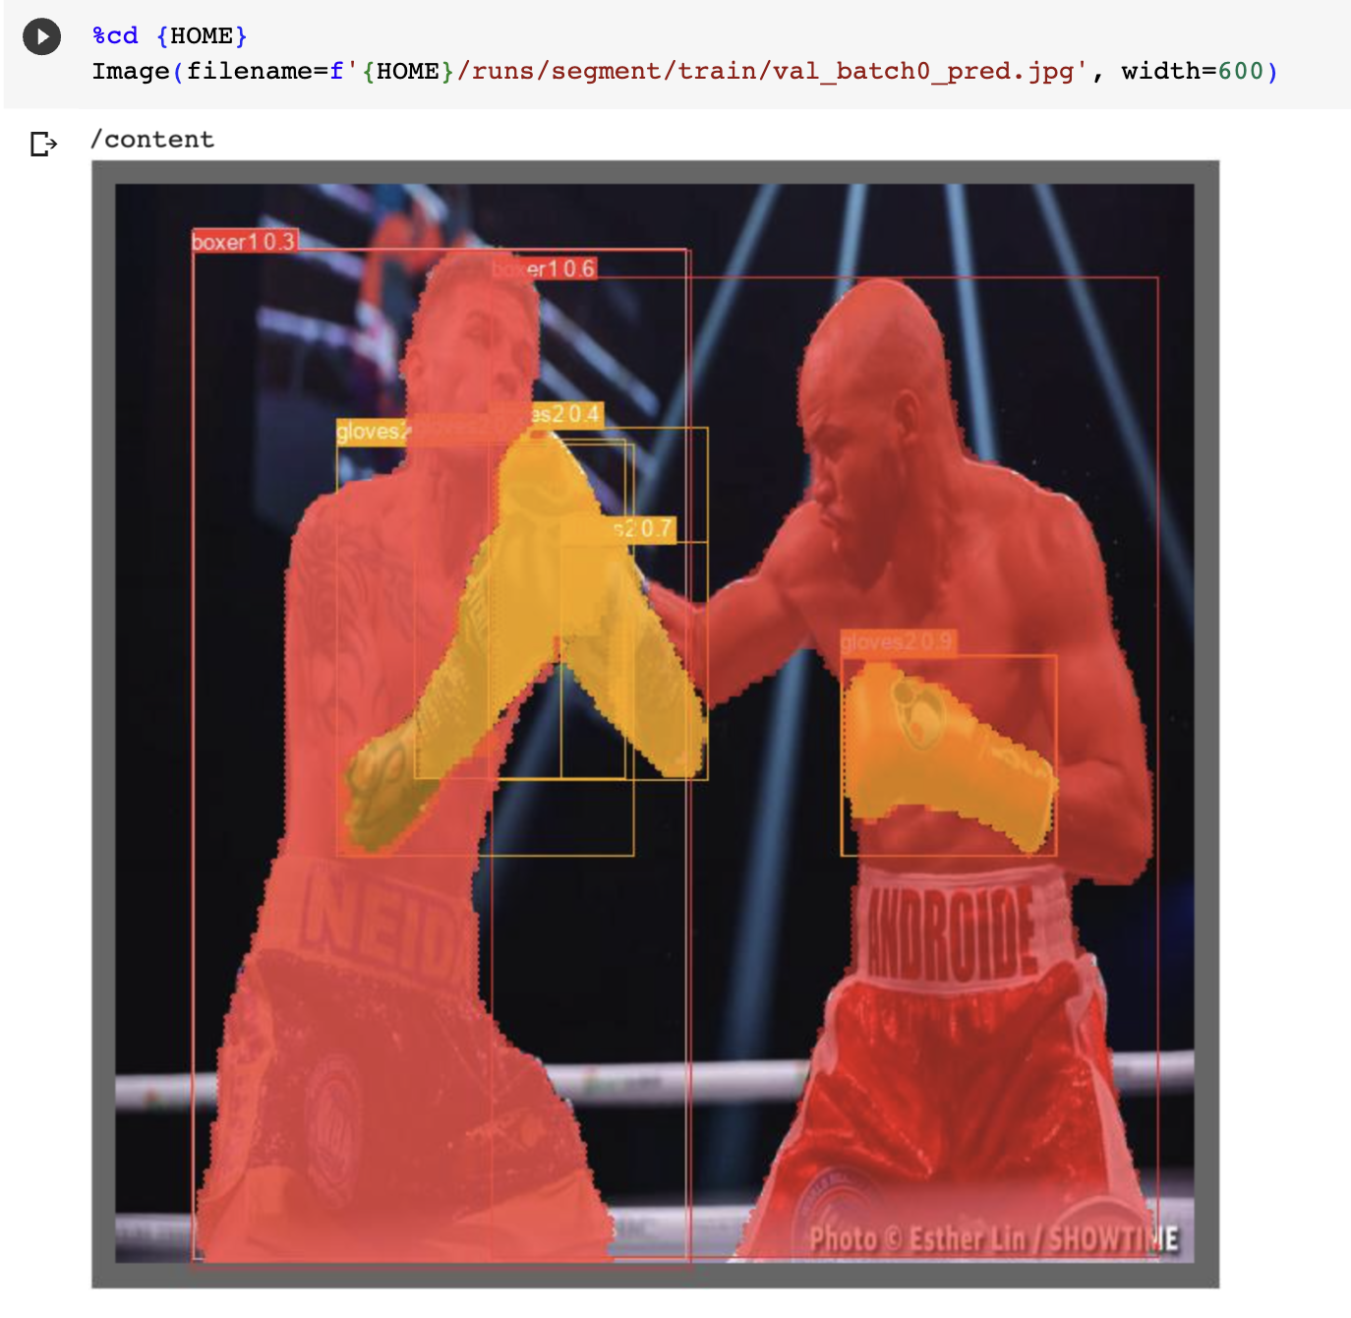
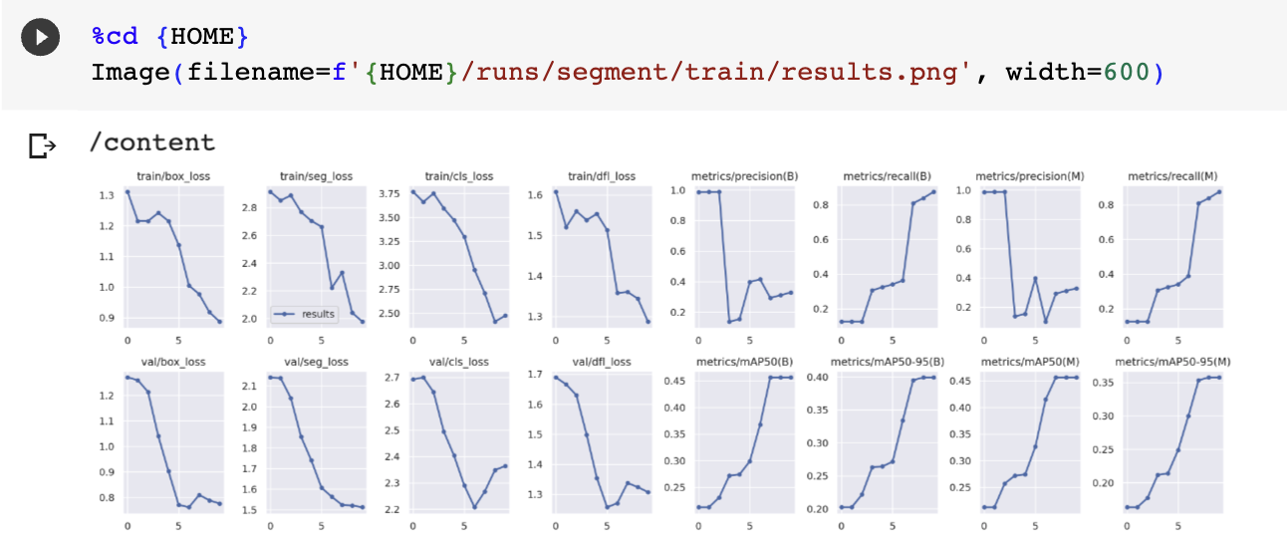
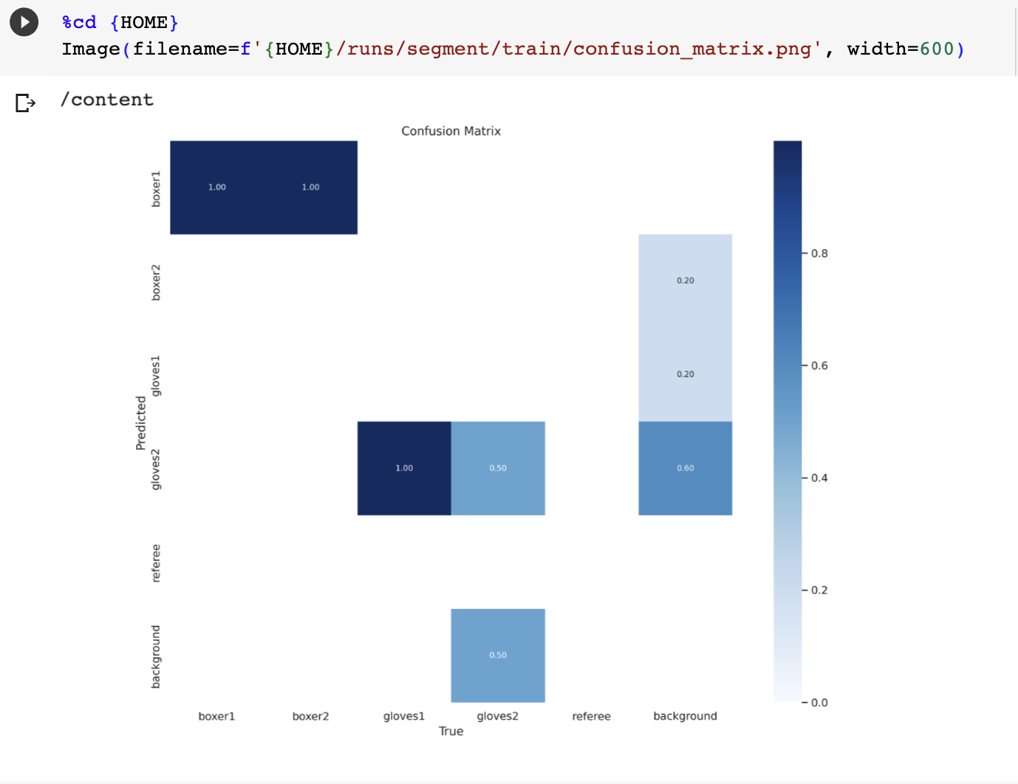
Prototype result
01.
Confusion matrix
Accurate on detecting boxers.
Not enough to detect boxing gloves.
02.
Test object detection
Using YOLOv8
Need to increase accuracy
by bigger dataset

Slide 13
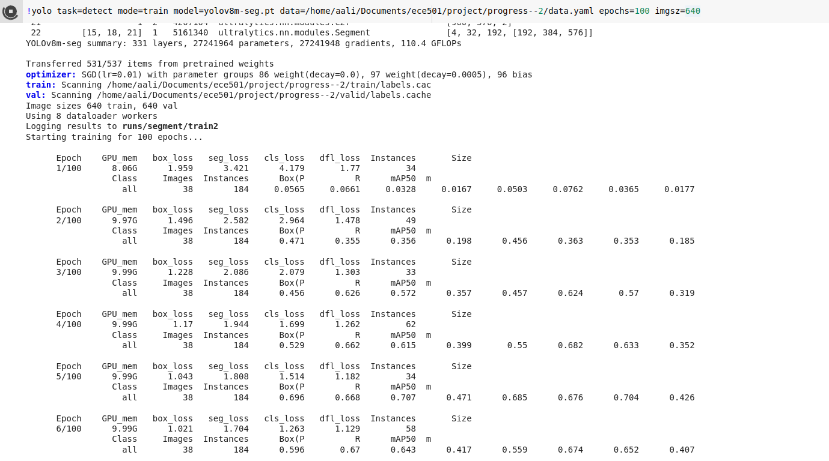
Model
01.
Instance Segmentation
Using Roboflow
Labeled about 200 images on Roboflow.
02.
Test Object detection
Used YOLOv8 on local machine to train model for detection

Slide 14
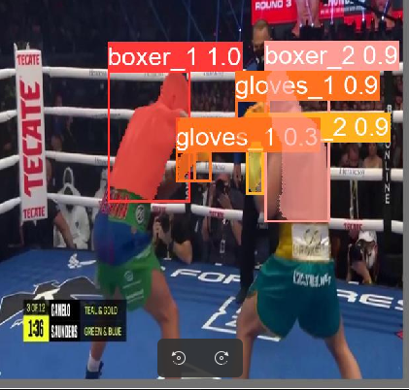
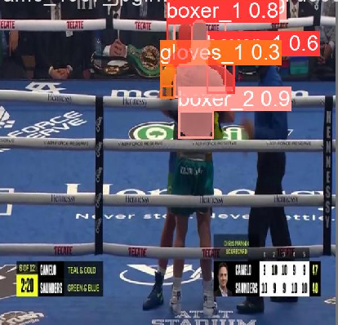
Model result
- Model can easily detect the different boxers and their respective gloves
- This increase in accuracy was mainly due to more epochs and an increase in the size of the dataset from 30 images to ~200 images

Slide 15
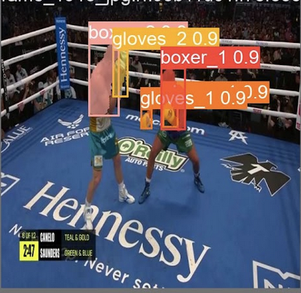
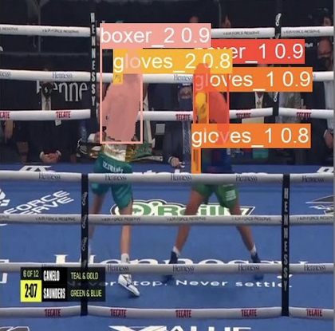
Model result

Slide 16
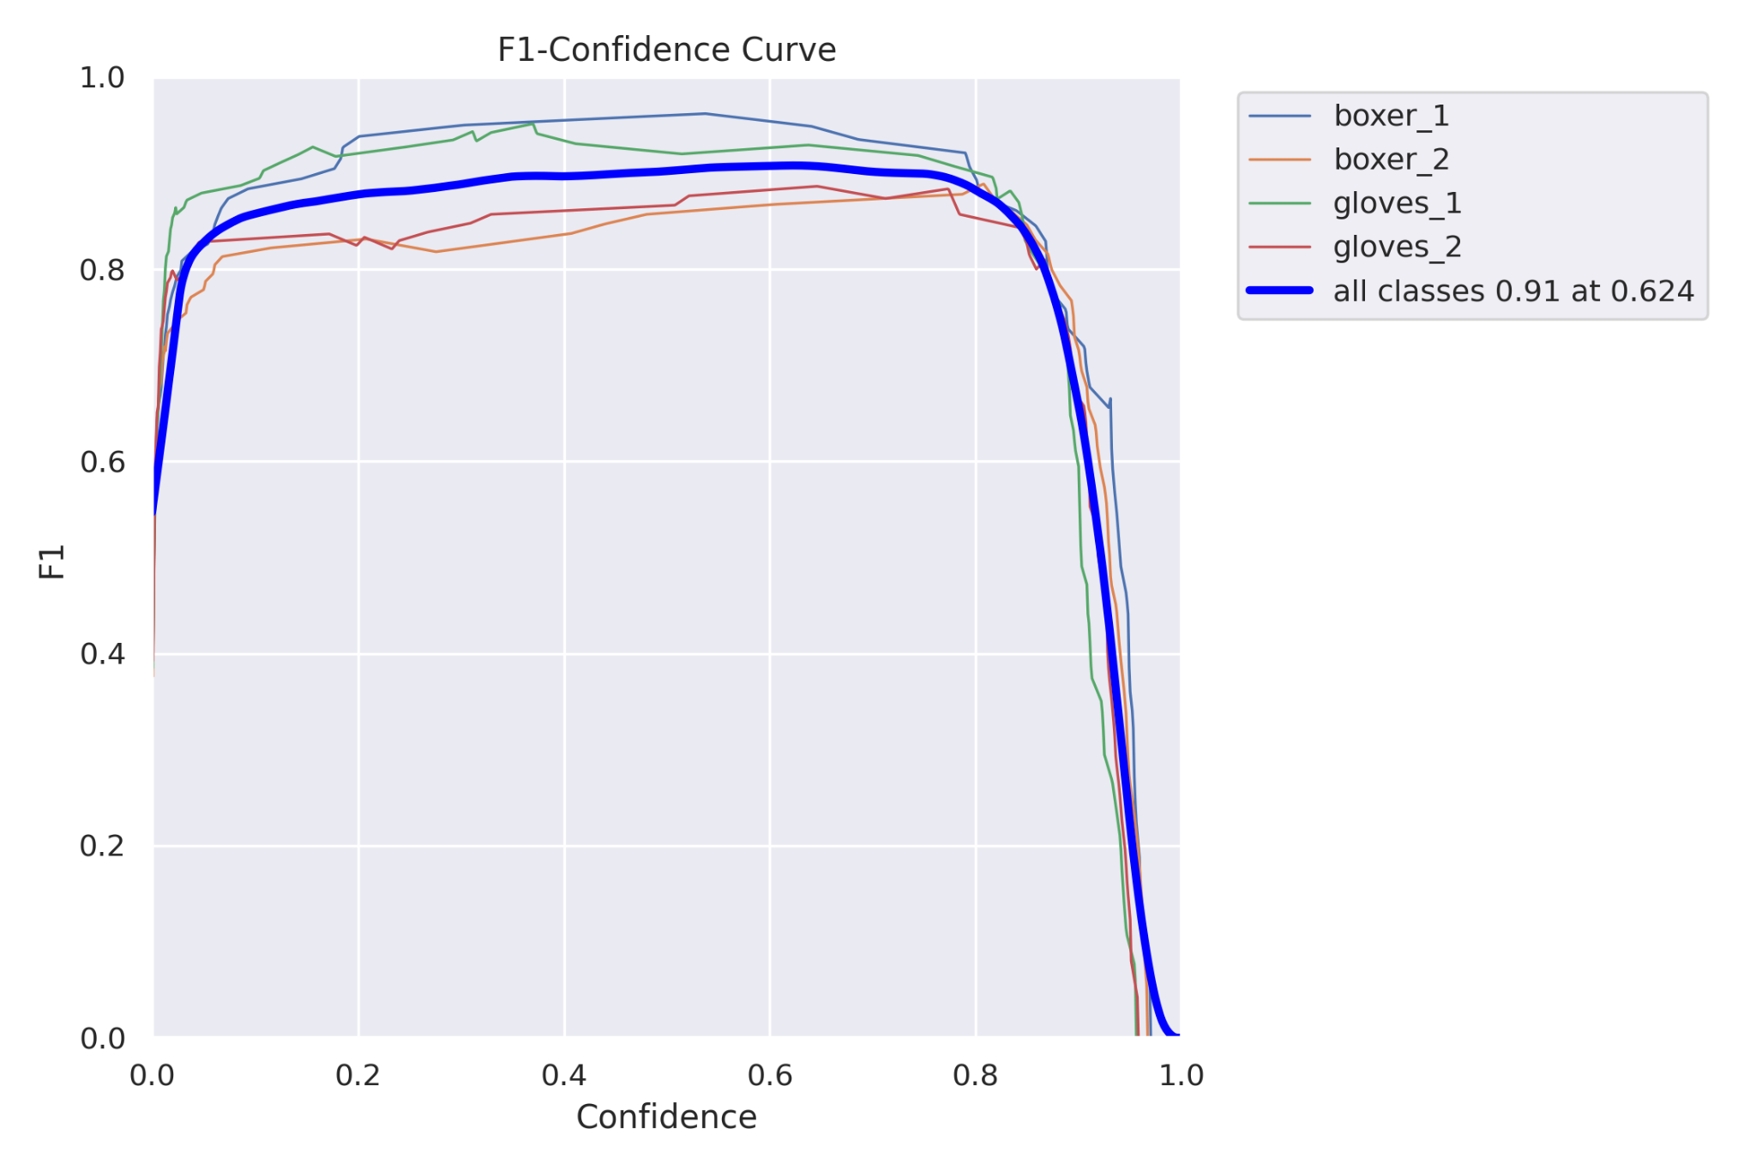
Model result(continued)
- F1 score peak is around 0.55 confidence
- Very high F1 score meaning that there is very high accuracy in lower confidence ranges.

Slide 17
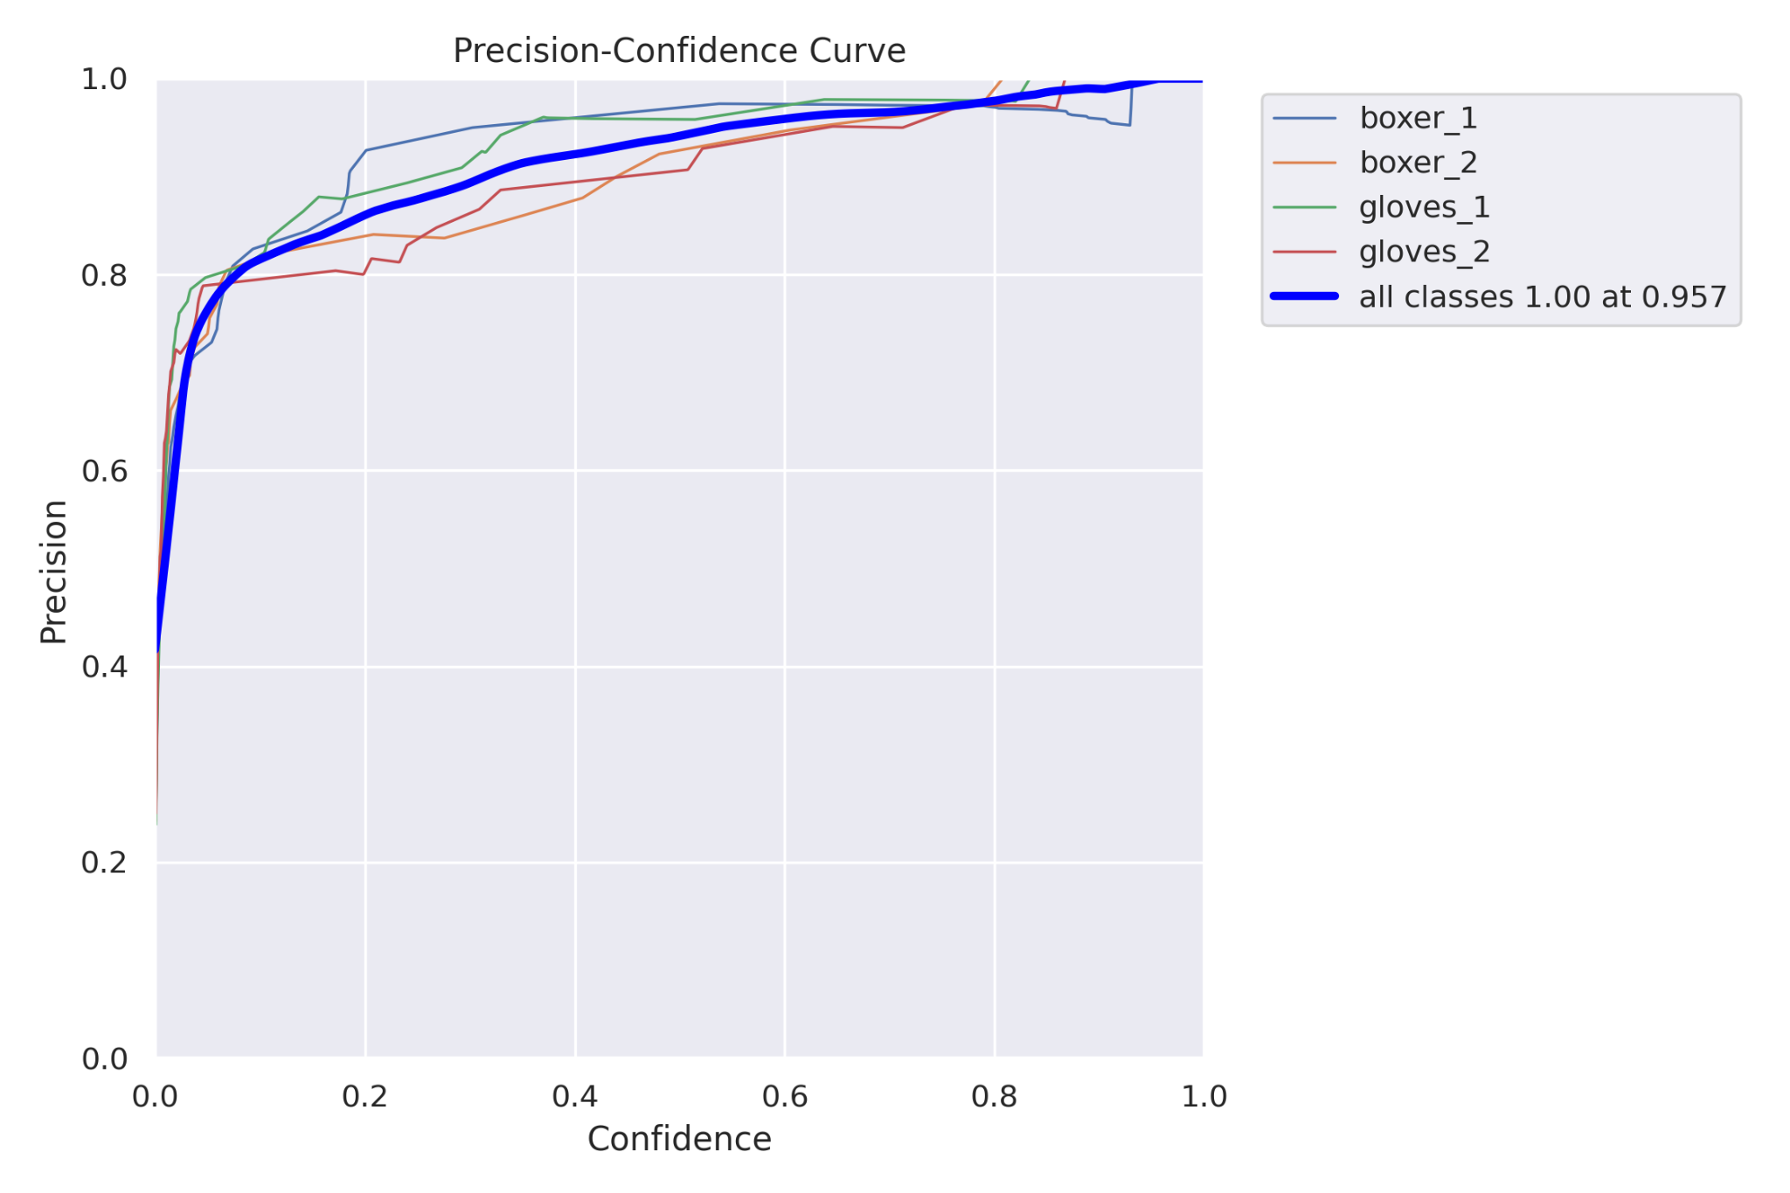
Model result(continued)
-Precision increases naturally as the confidence increases.
- The optimal confidence threshold is around 0.70. This would allow excellent precision while keeping good recall as well.

Slide 18
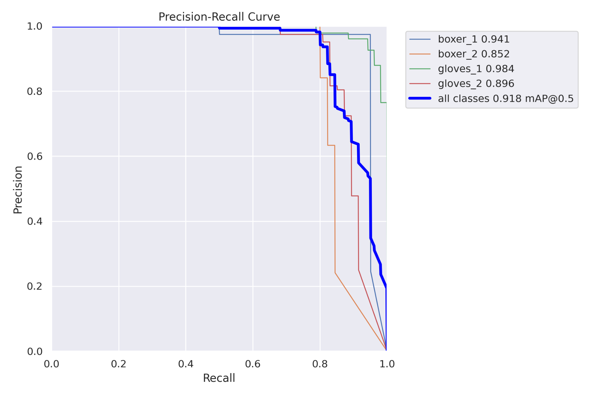
Model result(continued)
- The precision decreases as the model is able to find more true positives thus giving an increase in recall.
- When comparing these results to the prototype the results are night and day. The new model is able to accurately detect boxers and their gloves.

Slide 19
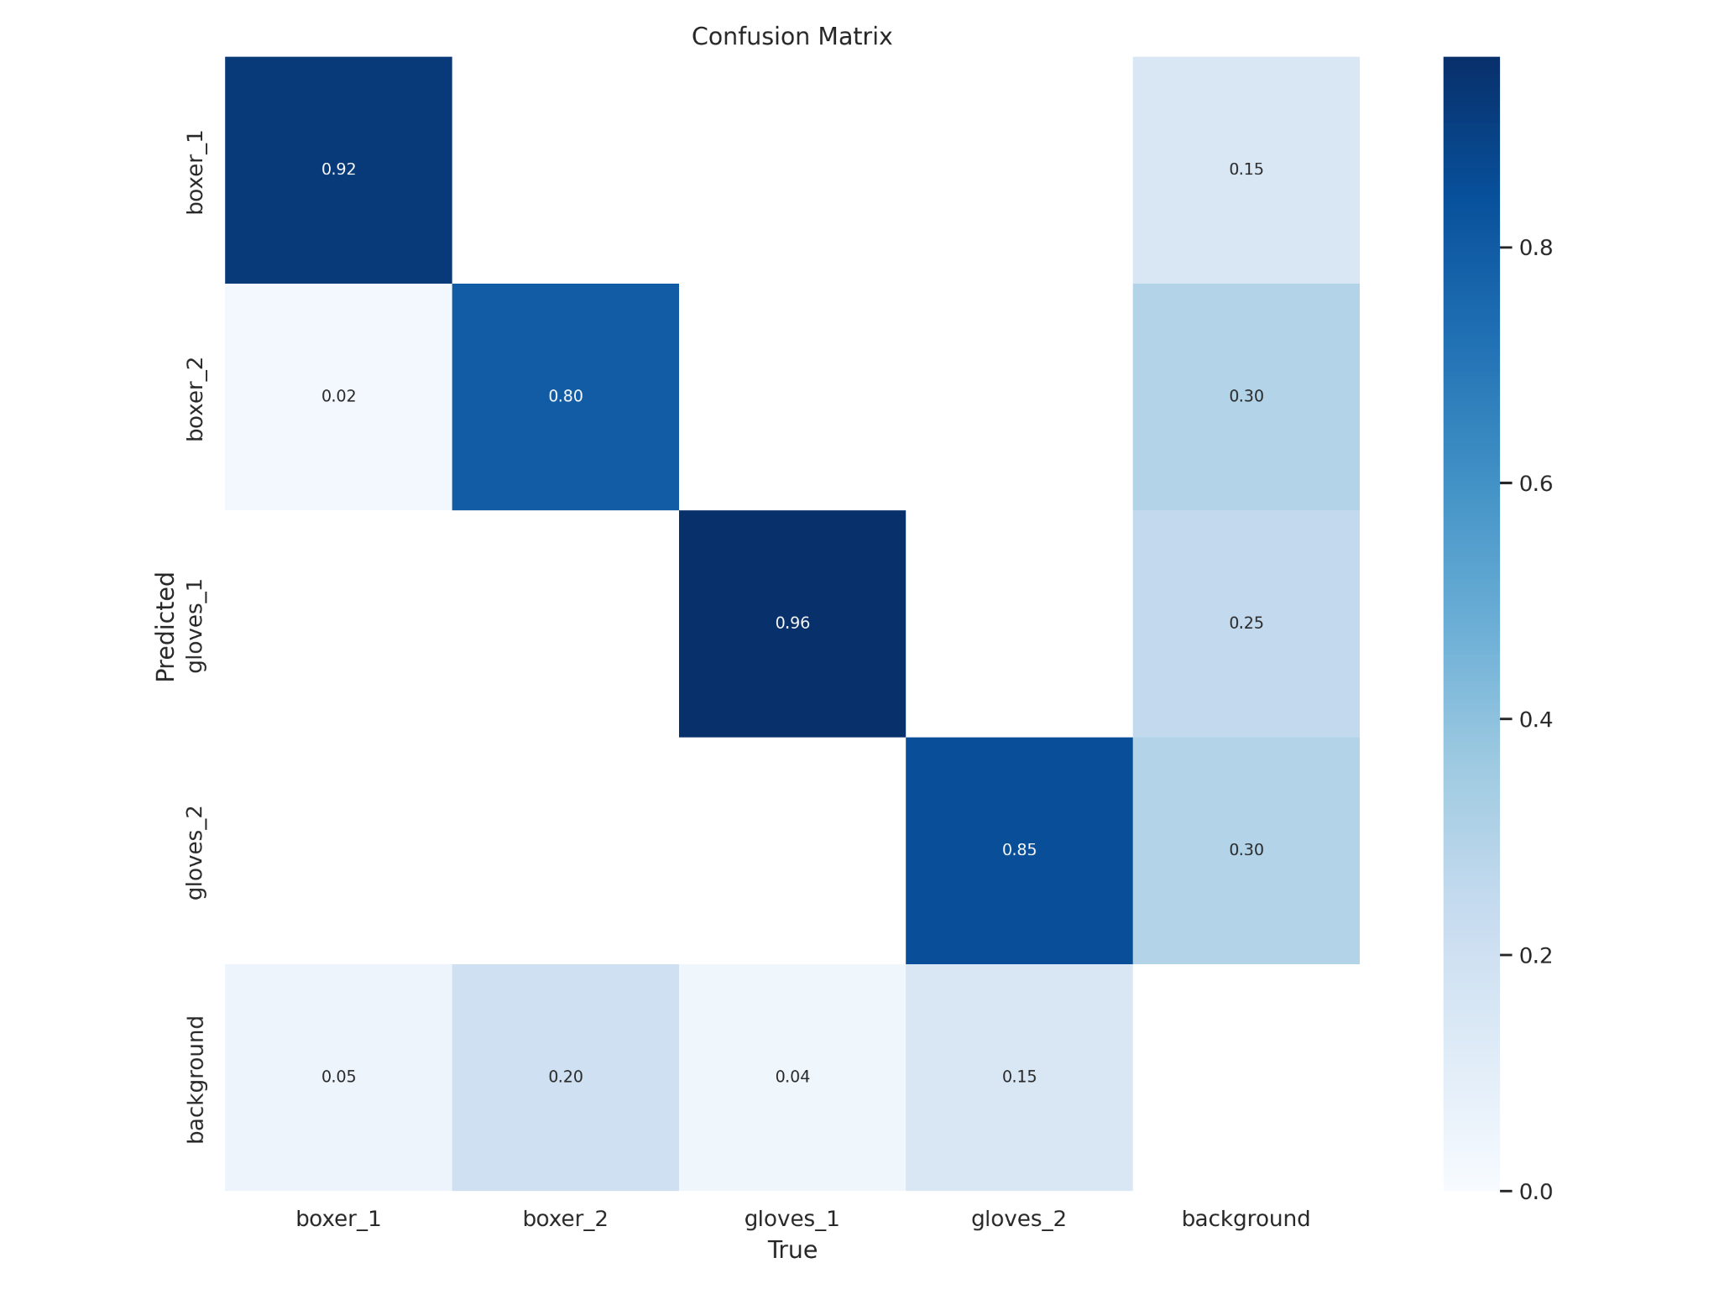
Model result(continued)
- As seen by the confusion matrix(dark blue is true positive) the precision is very high meaning that the model is very good in detecting boxers.
- When compared to the prototype confusion matrix(below) the results of adding more epochs and images show how impactful they are to a good model.

Slide 20
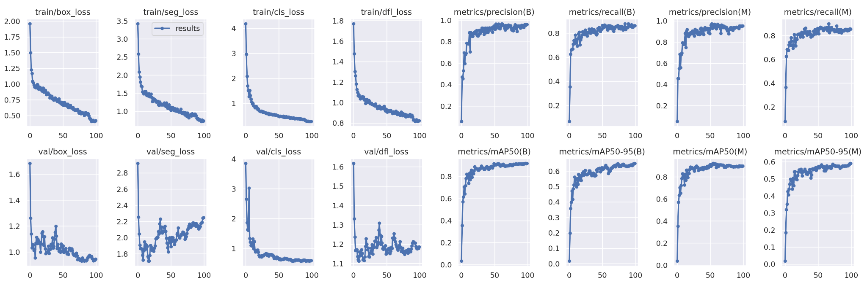
Model result(continued)
- The above graphs show how loss decreases compared to the number of epochs that are used. As seen, 100 epochs may have been too much and 80 might a better number of epochs to use as the gains are not much after 80.
- The mAP(mean Average Precision) increases drastically until around 50 epochs where the increase is more gradual then it peaks and flattens out around 80 epochs.

Slide 21
Hardware
CPU
GPU
5900x with 12 cores and 24 threads
Nvidia RTX 3080 with 12gb of vram
Memory
Storage
64 gb
2TB of nvme storage
Software
Roboflow
PyTorch

Slide 22
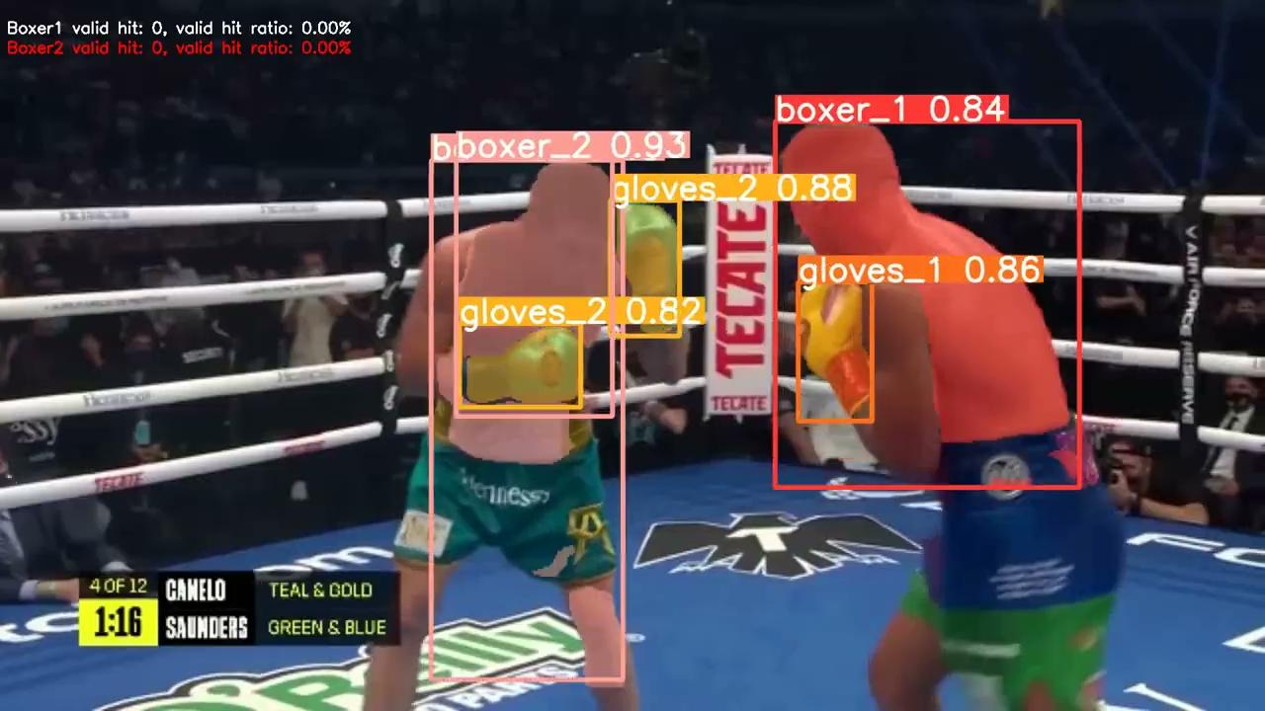
Demonstration Video

Slide 23
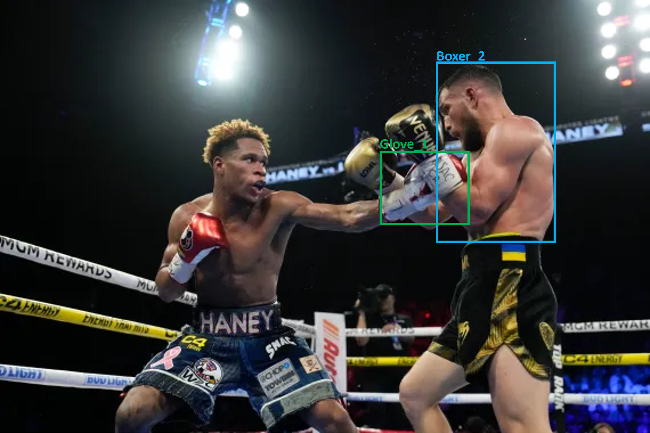
Post-processing: Counting Algorithm
Valid hits
To calculate whether the bounding boxer of boxer1’s glove is in contact or overlapping with the bounding box of boxer2’s body part and whether the previous frame did not contact or overlap to determine whether it is a valid hit for boxer1 at this time. The same method is used to calculate boxer2's score.

Slide 24
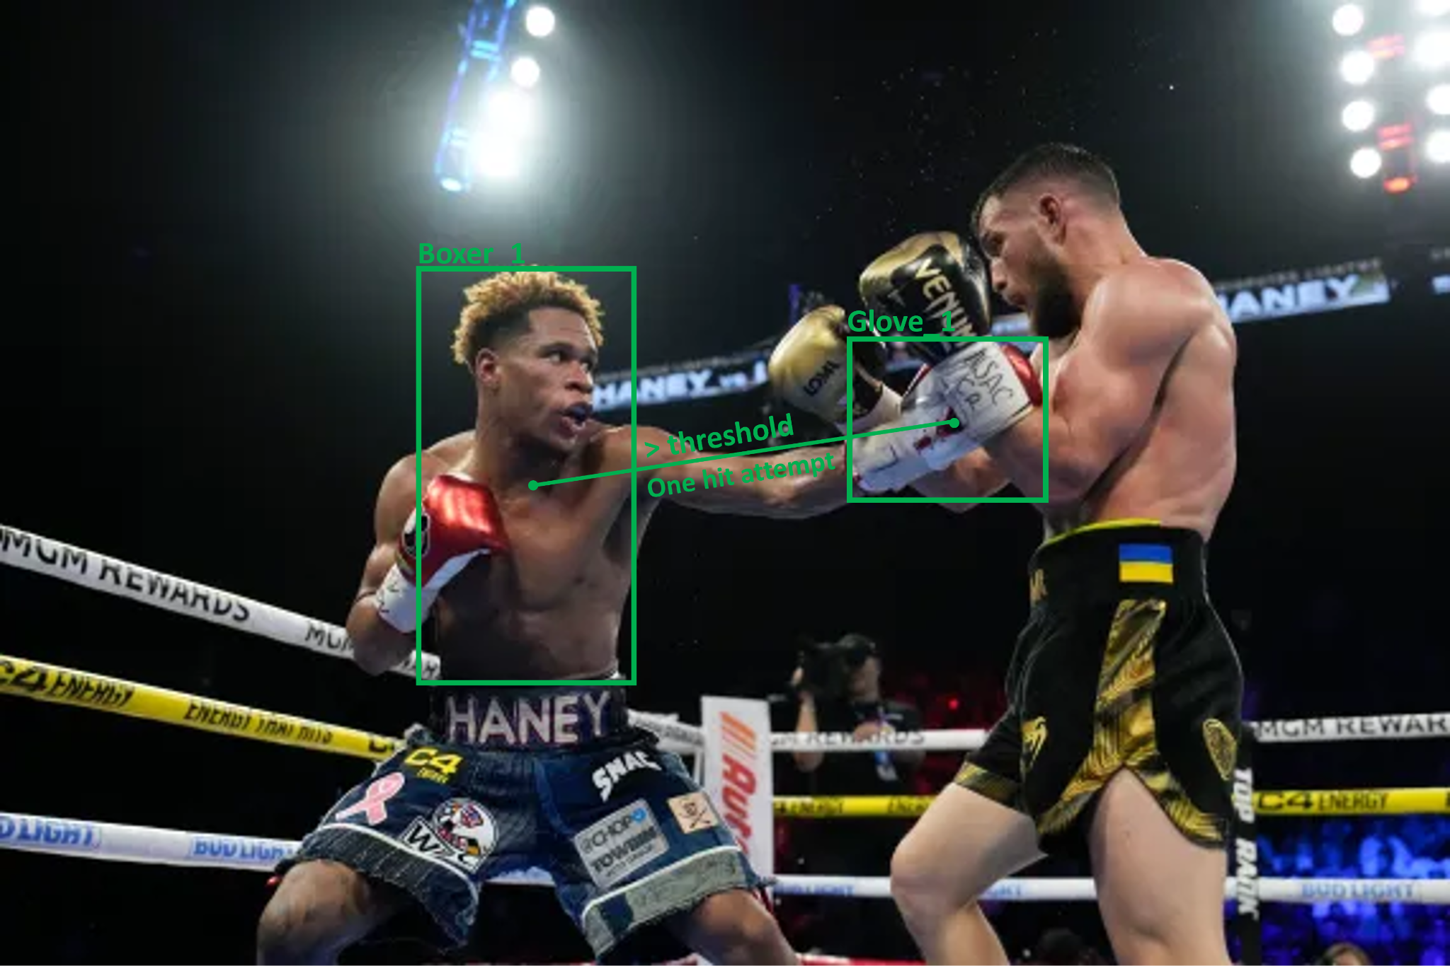
Post-processing: Counting Algorithm
Hits attempt
To calculate the distance from the center of the glove-bounding box to the center of the bounding box of the current boxer's body part. If this distance is greater than a specific threshold and the previous frame did not reach this threshold, then this is a punch attempt.

Slide 25
Algorithm Constraints and Future Work
Confidence adjustment
The probability of false and missed detections can be reduced by adjusting the threshold of confidence.
Algorithm adjustment
Using the predicted mask information to determine the effective hit will be more accurate. To extend the mask information of the glove and the opponent's body by one pixel outward and determine whether the two areas overlap.
User interface
Package the functionality and create a web page for users to upload boxing videos and download the completed analyzed videos.

Slide 26
Milestone and Task distribution
 | YoungJo Choi | Wenxuan Zhu | Ameer Ali | Objectives
June 2nd | Gather custom dataset. Labeled images using Roboflow. Run Yolo on the dataset. Made a prototype. |  |  | Make a prototype and check if there is a room for improvement.
June 9th | Collecting and labeling the custom dataset. Devise algorithms. Learning OpenCV. | Collecting and labeling the custom dataset | Implement train a YOLO model based on the custom dataset | Implement a motion detection algorithm that counts number of punches.
June 16th | Designing the punch detection algorithm | Designing the punch detection algorithm | Polish the code and run tests on it | Polish codes and run several tests.
June 23rd | Write publication. | Write publication. | Write publication. | Finish research publication.

Slide 27
Reference
[1] Liam, How is Boxing Scored? Points, Rules, Scores and Deductions used by judges and referees (2022)
https://www.dazn.com/en-US/news/boxing/how-is-boxing-scored-points-rules-scores-and-deductions-used-by-judges-and-referees/zncunu9sov881vkqqvvqlsu67
[2] w3schools. Python Classes and Objects. Retrieved from https://www.w3schools.com/python/python_classes.asp
[3] Tutorials Point. Python Classes. Retrieved from https://www.tutorialspoint.com/python/python_classes_objects.htm
[4] Real Python. Python Classes: Intro, Methods, Attributes. Retrieved from https://realpython.com/python3-object-oriented-programming/
[5] Redmon, Joseph, and Ali Farhadi. "YOLO9000: better, faster, stronger." Proceedings of the IEEE conference on computer vision and pattern recognition. 2017.

Slide 28
Thank you !
Questions?

